Slide 1

3D printed picks
The next step in lock picking
By Ben Lampere
Notes:
Welcome
NEXT: Who am I

Slide 2
Who am I?
Name: Ben Lampere
Alias: Fl0rbu5
Occupation: Android Developer
CTF Team: B0tchsec
First Lockpicking set: 15th birthday
Notes:
Name
Alias
Job
CTF
Lockpicking first
NEXT: SSP

Slide 3
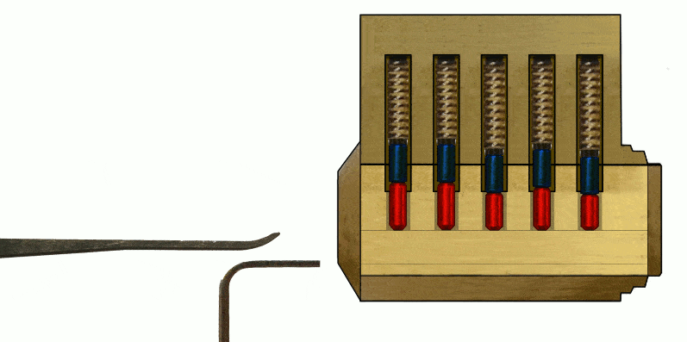
Methods to pick locks
Single pin picking (SSP)
Notes:
Use a tension wrench and “hook” pick to press individual pins
NEXT: Raking

Slide 4
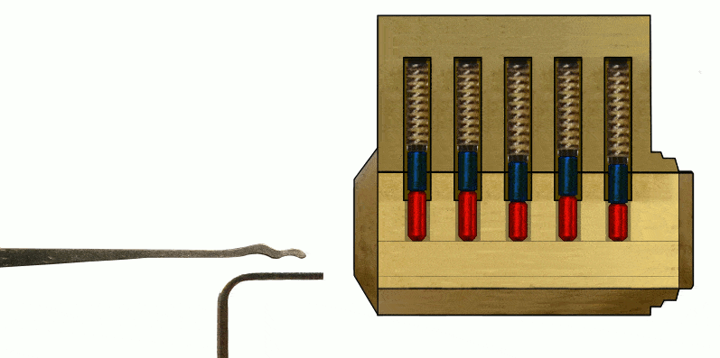
Methods to pick locks
Single pin picking (SSP)
Raking
Notes:
Uses a tension wrench to “rake” the pins
Using probability to push all pins up
Best first attempt
NEXT:BUMP

Slide 5
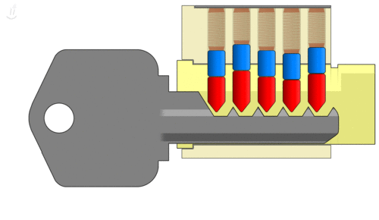
Methods to pick locks
Single pin picking (SSP)
Raking
Bump keys
Notes:
No tension wrench
Uses rubber hammer to push key in
NEXT: DUPLICATE

Slide 6
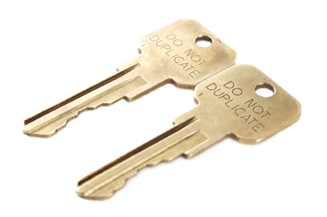
Methods to pick locks
Single pin picking (SSP)
Raking
Bump keys
Key duplication
Notes:
3D prints give us this option
NEXT: WHY MATTERS

Slide 7
Why does this matter?
Cheap - Your average set of 4-6 lock picks cost around $25
Customization - a 3D printer allows you to create picks with accuracy down to .1 mm in most commercial printers
Fast access - Most of these prints take around 30 minutes to complete
Notes:
Cheap - $25 4-6 picks
Customization - .1mm accuracy
Fast Access - 30 mins to print
NEXT: LEGAL

Slide 8
https://www.law.cornell.edu/uscode/text/39/3002a
39 U.S. Code § 3002a.
Nonmailability of locksmithing devices
(a)Any locksmithing device is nonmailable mail, shall not be carried or delivered by mail, and shall be disposed of as the Postal Service directs, unless such device is mailed to—
(1)a lock manufacturer or distributor;
(2)a bona fide locksmith;
(3)a bona fide repossessor; or
(4)a motor vehicle manufacturer or dealer.
(b)For the purpose of this section, “locksmithing device” means—
(1)a device or tool (other than a key) designed to manipulate the tumblers in a lock into the unlocked position through the keyway of such lock;
(2)a device or tool (other than a key or a device or tool under paragraph (1)) designed for the unauthorized opening or bypassing of a lock or similar security device; and
(3)a device or tool designed for making an impression of a key or similar security device to duplicate such key or device.
Notes:
One other reason is it’s the only technically legal way to get lock picks if not bought in store
Is this law enforced...No.. does anyone care….no
NEXT: WHAT TOOLS

Slide 9
What tools were used for this project?
Notes:
What tools were used for this project
NEXT: CALIPER

Slide 10
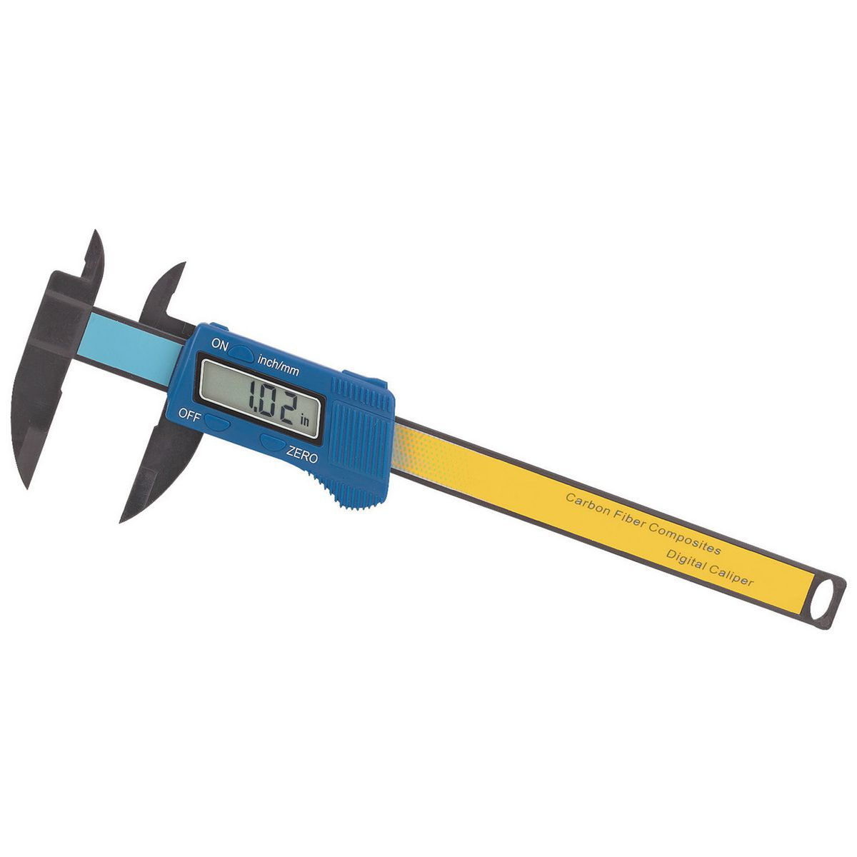
Caliper
~$10 on Amazon
Notes:
Get one that messures down to .1mm. And make sure it messures in mm’s
NEXT: DIGITAL PROTRACTOR

Slide 11
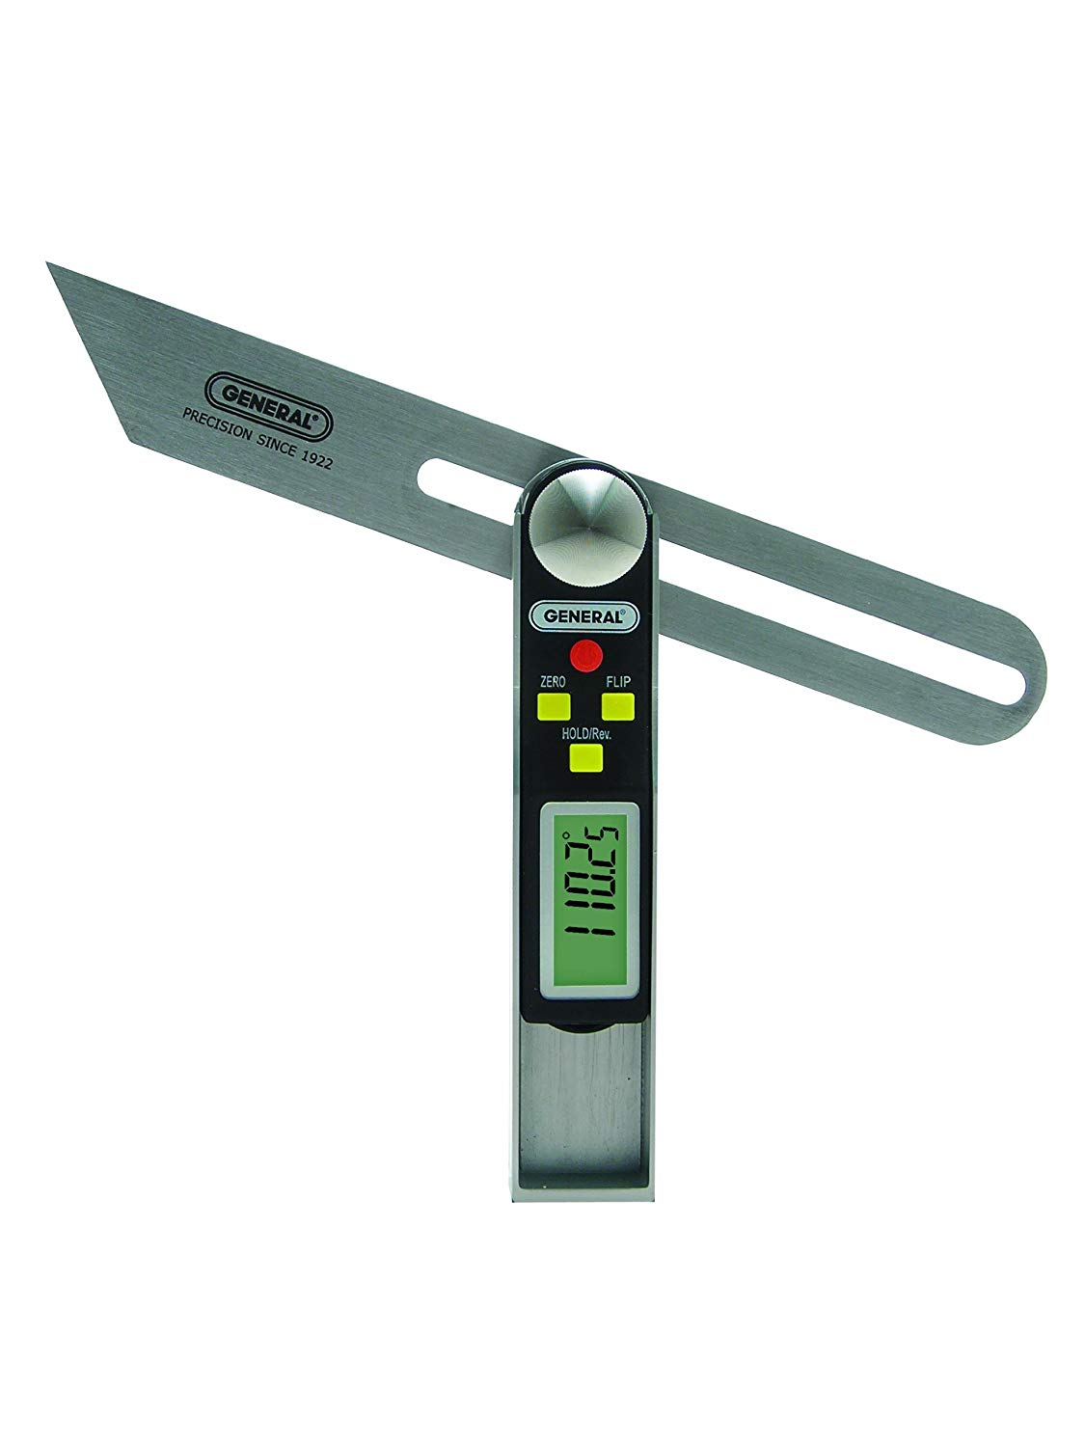
Digital Protractor
~$10 on Amazon
Notes:
This is for a specific type of lock that I will show later in this talk but keep in mind it’s only 10 dollars
NEXT: 3D PRINTER

Slide 12
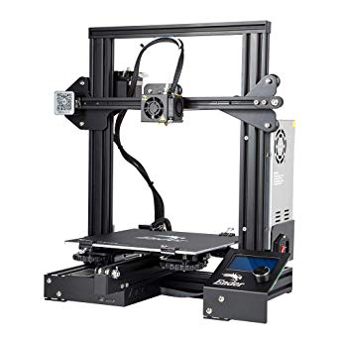
3D Printer
(I used an Ender 3)
~$230 on Amazon
Notes:
One of the most popular printers
Can print any type of filament at 1.5mm
NEXT: OPTIONAL ITEMS

Slide 13
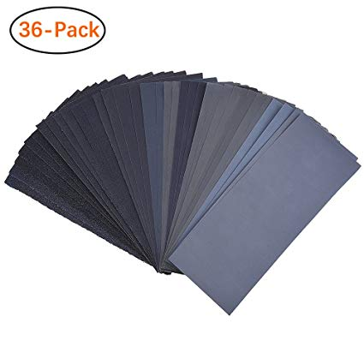
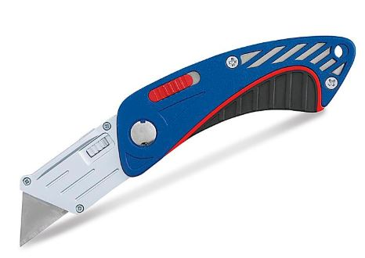
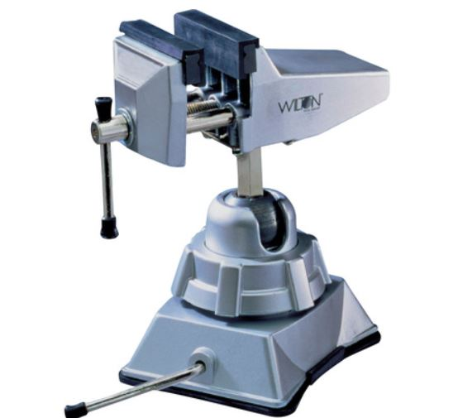
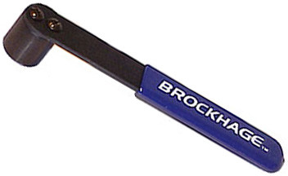
Optional items
Bump hammer
Sand paper
Razors
Jewelry Vise
Notes:
Bump Hammer
Sand Paper
Razors
Vice
NEXT: FILAMENTS

Slide 14
Filaments
PLA
Easy to print but not durable
ABS
Stronger but difficult to print
Polycarbonate
Strong and relatively easy to print
Nylon
Very Strong but hard to print
Sadly no Amphora because it’s only sold in 2.85mm
Notes:
All the 3D prints in a white filament you will see in this talk is Polycarbonate
Stronger than all
Easier to print than Nylon
Common filament
Cheap
NEXT: SAFETY WARNING

Slide 15
Safety Warning
Do NOT use a stock Ender 3 to print Polycarbonate or Nylon filaments. These filaments require temperatures when reached PTFE tubing starts to release fumes. This can cause serious lung damage and nerve damage.
UPGRADE YOUR HOTEND
Notes:
Polymer flume fever.
Replace hotend
Replace tubing
NEXT CAN WE SSP

Slide 16
Can we Single Pin Pick (SSP) a lock open with plastic pick?
Notes:
Can we SSP a lock open with a plastic pick?
NEXT: LIVE DEMO

Slide 17
LIVE DEMO!
Notes:
Live Demo
NEXT: DEMO FAIL VIDEO

Slide 18
Live Demo didn’t work so here is a video instead.
Notes:
Failed Demo
NEXT: YES WE CAN

Slide 19
Can we pick open a lock with a plastic pick?
Yes.
Notes:
Yes
NEXT: POSSIBLE ISSUES

Slide 20
Possible issues
Thinner the pick the less strength you have to push up the pins
Loss of feedback compared to metal picks
Easily can be bent
Notes:
Thinner the pick the less strength you have to push up the pins
Loss of feedback compare to metral picks
Easily can be bent
NEXT: RAKE CAN WE

Slide 21
Can we rake a lock open with a plastic pick?
Notes:
Can we rake a lock open with a plastic pick?
NEXT: RAKE VIDEO

Slide 22
Notes:
Rake video
NEXT: YES WE CAN

Slide 23
Can we rake a lock open with a plastic pick?
Yes.
Notes:
Yes.
NEXT: POSSIBLE ISSUES

Slide 24
Possible issues
Plastic picks sometimes won’t be strong enough rake the back pins (Solution: use the long handle of tension wrench to hold the pick up)
Can bend if you get over overzealous
Notes:
Plastic picks sometimes won’t be strong enough rake the back pins (Solution: use the long handle of tension wrench to hold the pick up)
Can bend if you get over overzealous
NEXT: CAN WE BUMP

Slide 25
Can we bump a lock open?
Notes:
NEXT: BUMP DESIGN

Slide 26
Legal warning
§ 19-2.5 - Unlawful sale of burglary tools. (a) For the purposes of this Section:
"Lock bumping" means a lock picking technique for opening a pin tumbler lock using a specially crafted bump key.
(b) A person commits the offense of unlawful sale of burglary tools when he or she knowingly sells or transfers any key, including a key designed for lock bumping, or a lock pick specifically manufactured or altered for use in breaking into a building, house trailer, watercraft, aircraft, motor vehicle, railroad car, or any depository designed for the safekeeping of property, or any part of that property.
Notes:
NEXT: BUMP DESIGN

Slide 27
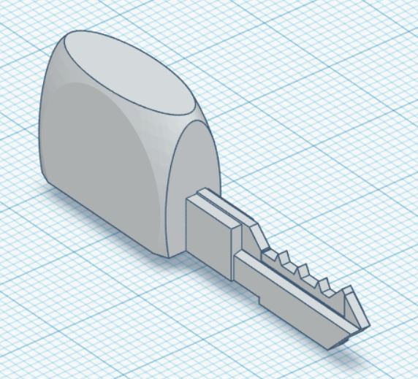
Bump Key Design
Master lock bump key
All set to the lowest notch
Notches between pins are 1mm in height
Large back to make it easier to hit with Hammer
Notes:
Bump key design
NEXT: BUMP IT VIDEO

Slide 28
Bump it
Notes:
Bump key video
NEXT: NO WE CANT

Slide 29
Can we bump a lock open with a plastic bump key?
No...well atleast I couldn’t
Notes:
No well atleast I couldn’t
NEXT: POISSBLE PROBLEMS

Slide 30
Possible Problems
Plastic don’t transfer energy as well as metal
Plastic is too soft
Notes:
Possible problems
NEXT: CAN WE DUP A KEY

Slide 31
Can we duplicate a key?
Notes:
Can we duplivate a key
NEXT: MESSURE A KEY

Slide 32
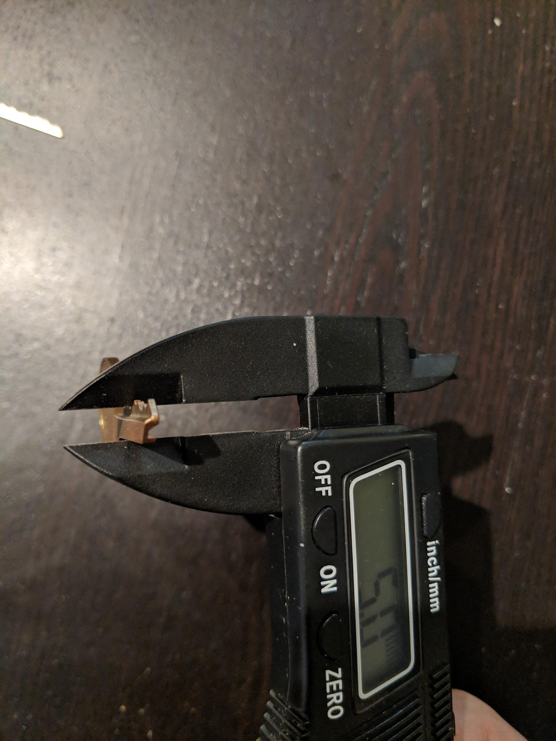
Measure the Key
Take caliper and measure each notch.
Measure the width of each notch as well
Notes:
Messure the Key
NEXT: DESIGN THE KEY

Slide 33
Design the key
tinkercad.com
Notes:
Design the key video
NEXT: DUP KEY VIDEO

Slide 34
Alternative Design the key
Take photo of key with white background
Use photo editing software and remove the white background
Convert JPG file to SVG https://image.online-convert.com/convert-to-svg
Convert SVG to STL
Use that design and merge it with the blank key file I have provided
Notes:
Design the key video
NEXT: DUP KEY VIDEO

Slide 35
Duplication Key Video
Notes:
NEXT: YES WE CAN SORT OF

Slide 36
What about high security locks?
Notes:
NEXT: YES WE CAN SORT OF

Slide 37
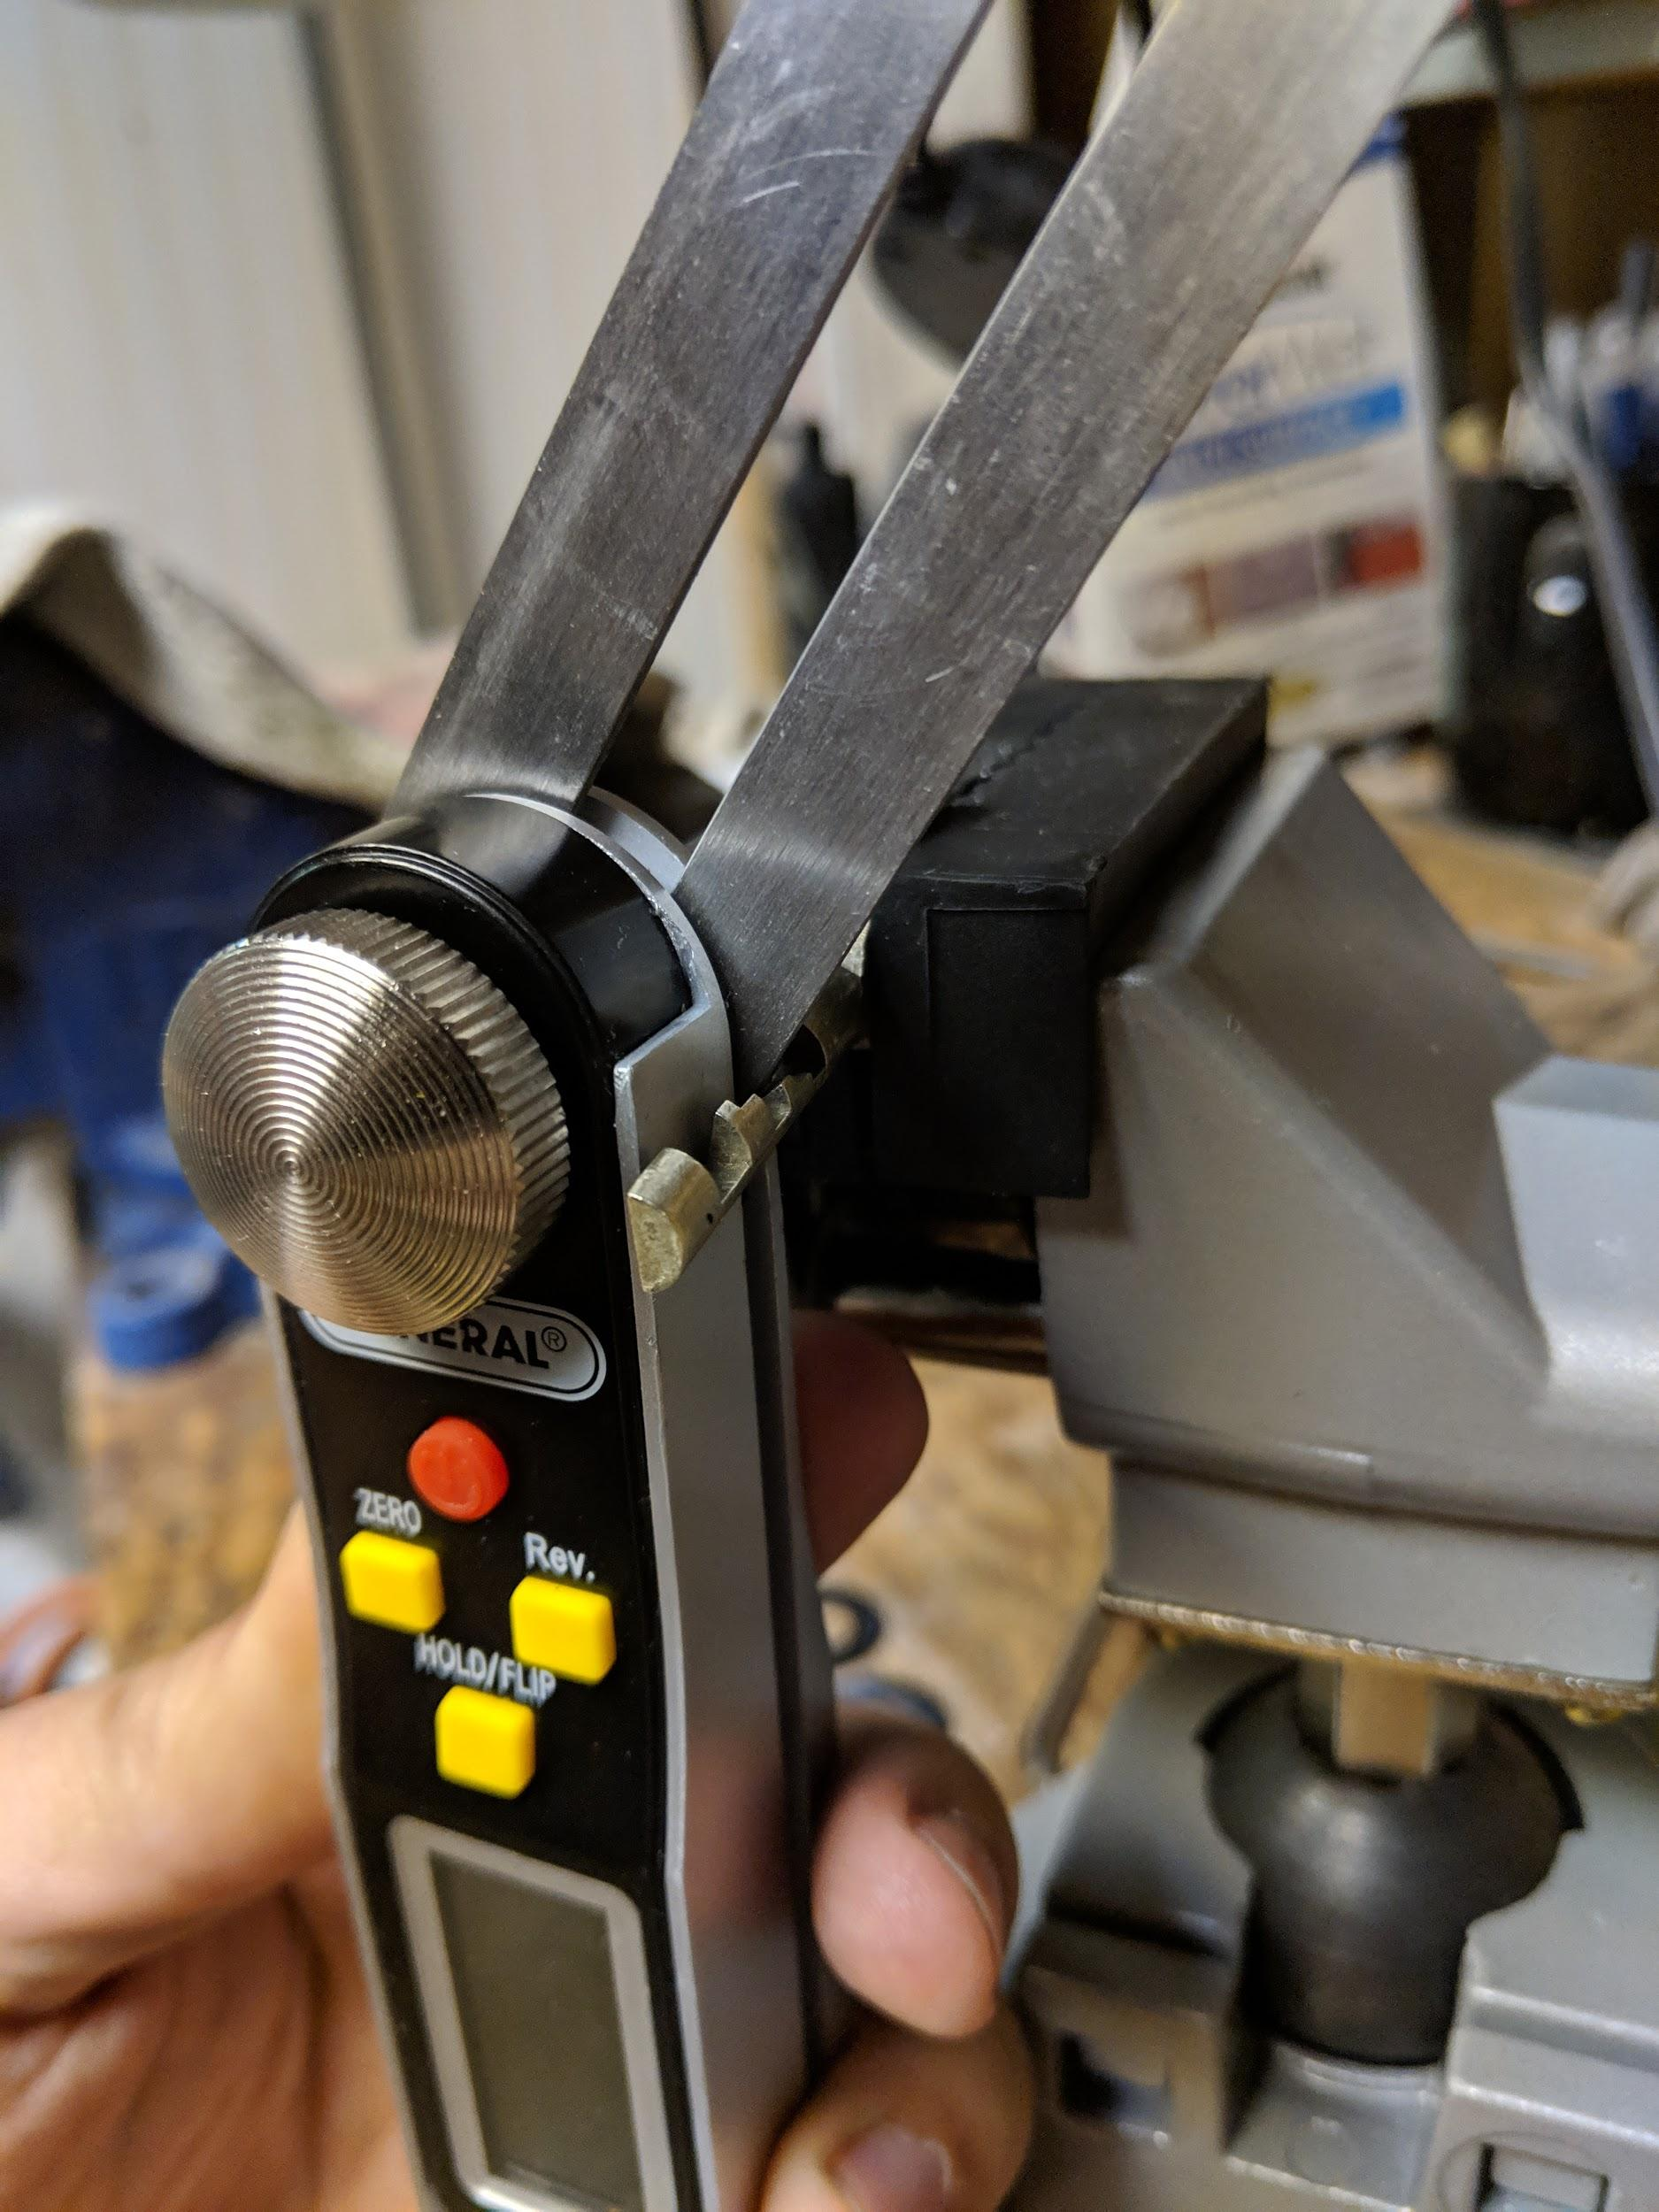
Measure the Key
Take the digital protractor and measure the angle
Take the caliper and measure the width
Notes:
Messure the Key
NEXT: DESIGN THE KEY

Slide 38
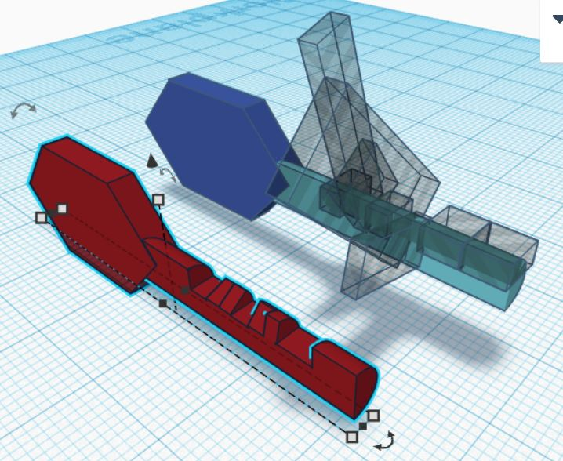
Design the Key
Create boxes with the width of each cut
Enter the angle of each cut
Notes:
NEXT: YES WE CAN SORT OF

Slide 39
Duplication of High Security Key
Notes:
NEXT: YES WE CAN SORT OF

Slide 40
Can we duplicate a key?
Yes* (no high security)
Notes:
NEXT: YES WE CAN SORT OF

Slide 41
Possible issues
Higher security keys have higher tolerances that may not work
Key has a chance of breaking in the lock
Notes:
Plastic picks sometimes won’t be strong enough rake the back pins (Solution: use the long handle of tension wrench to hold the pick up)
Can bend if you get over overzealous
NEXT: CAN WE BUMP

Slide 42
Summary
Method | Does it work
Single pin picking | Yes
Raking | Yes
Bump Keys | No
Duplication | Yes*
Notes:
Summary
NEXT: FURTHER RESEARCH

Slide 43
Further Research
Different Materials
Resin printers
Different types of locks

Slide 44
THANK YOU
https://github.com/Sheepwiz/3DLockpicks
www.linkedin.com/in/benlampere

